Slide 1

SESSION 2026-2027
BARBECUE – LIVE POSTURE DETECTION AND REP COUNTER
PRESENTED BY :
Student Name (Roll No.)
Student Name (Roll No.)
Student Name (Roll No.)
Student Name (Roll No.)
UNDER SUPERVISION OF :
Dr. / Mr. / Ms. Supervisor Name
Designation of Supervisor
CSE-AIML, GLBITM
Bar = Barbell · Cue = Reminding & Coaching

Slide 2
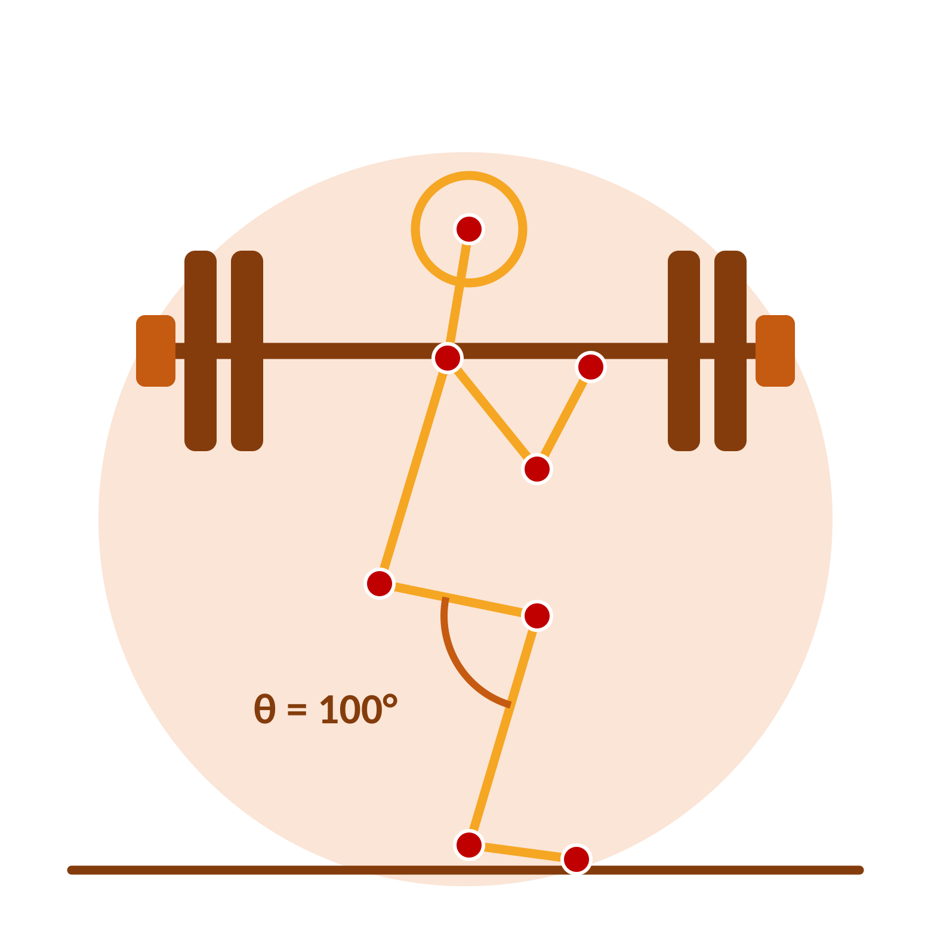
INTRODUCTION OF THE PROJECT
BarBeCue
Live Posture Detection and Rep Counter
BarBeCue is a real-time computer-vision fitness coach. It watches one user through a standard laptop webcam, estimates body pose with a pre-trained model, converts joints into biomechanical angles, checks posture against per-exercise rules and counts repetitions with a hysteresis state machine.
Foundation: pose estimation → angle geometry → smoothing → rules and rep logic
Runs fully on a laptop CPU: no GPU and no model training
Private by design: video stays on device; hints are general fitness guidance
Knee angle θ drives squat depth, rep count and form hints
33
20–30
7
pose landmarks
FPS on CPU
exercise configs

Slide 3
LITERATURE SURVEY (15 papers) – 1/3
S. No | Date | Year | Author | Title | Published in | Conceptual Framework | Methodology | Conclusion | Future research
1. | Jun 2020 | 2020 | V. Bazarevsky et al. | BlazePose: On-device real-time body pose tracking | CVPR Workshops, pp. 1–8 | 33-landmark pose tracking | GHUM body fitting; real-time CPU inference | Heel, foot index and visibility enable squat, heel and head checks | 2D only; angles depend on camera view
2. | Accessed 2026 | 2026 | Google MediaPipe | Pose Landmarker guide | Online documentation | Lite, full and heavy pose models | Tasks VIDEO API; image and world coordinates | Full variant with detect_for_video chosen as default | World landmarks for 3D angle work
3. | Accessed 2026 | 2026 | G. Jocher et al. | Ultralytics pose estimation docs | Online documentation | YOLO-Pose, 17 COCO keypoints | Easy training; workout monitoring solution | Angle-threshold idea reused; AGPL-3.0 copyleft noted | No heel or toe keypoints
4. | 2023 | 2023 | T. Jiang et al. | RTMPose: Real-time multi-person pose estimation | arXiv preprint | Multi-person real-time pose | ONNX path via rtmlib, no mmcv or mmpose | RTMPose-s used as accuracy-focused comparison backend | Fast-changing library API
5. | Jan 2019 | 2019 | Z. Cao, G. Hidalgo, T. Simon, S. Wei, Y. Sheikh | OpenPose: Realtime multi-person 2D pose | IEEE TPAMI, 43(1), 172–186 | Part affinity fields | Bottom-up multi-person 2D pose | Historically key but too slow without GPU for live coaching | Reference only in BarBeCue
Focus: reuse a pre-trained pose model, innovate in the geometry, filtering, rules and evaluation layer above it.

Slide 4
LITERATURE SURVEY (15 papers) – 2/3
S. No | Date | Year | Author | Title | Published in | Conceptual Framework | Methodology | Conclusion | Future research
6. | Accessed 2026 | 2026 | TensorFlow | MoveNet Lightning and Thunder | Online documentation | Lightweight pose models | Lightning 4.8 MB, Thunder 12.6 MB (FP16) | Thunder 72.0 AP, Lightning 63.0 AP; light fallback | Browser and mobile path
7. | Sep 2014 | 2014 | T. Lin et al. | Microsoft COCO: Common objects in context | ECCV, pp. 740–755 | COCO keypoint dataset | Defines the 17-point skeleton | No heel or toe, so knee over toe stays zero on 17-point models | Richer foot keypoints
8. | Jun 2014 | 2014 | M. Andriluka, L. Pishchulin, P. Gehler, B. Schiele | 2D human pose estimation: New benchmark | CVPR, pp. 3686–3693 | MPII Human Pose benchmark | About 25,000 images of everyday and sports poses | Diversity supports generalisation to home workouts | Fitness-specific labels
9. | May 2012 | 2012 | G. Casiez, N. Roussel, D. Vogel | 1 Euro filter: Speed-based low-pass filter | CHI, pp. 2527–2530 | Adaptive noise filtering | Smooths slow motion, follows fast motion | EMA by default; upgrade to 1 Euro if flicker persists | Parameter tuning per user
10. | Accessed 2026 | 2026 | OpenMMLab | rtmlib: Lightweight RTMPose inference | GitHub repository | Dependency-light RTMPose | Performance, balanced, lightweight modes | Follow README signature as library evolves | API stability
Focus: reuse a pre-trained pose model, innovate in the geometry, filtering, rules and evaluation layer above it.

Slide 5
LITERATURE SURVEY (15 papers) – 3/3
S. No | Date | Year | Author | Title | Published in | Conceptual Framework | Methodology | Conclusion | Future research
11. | Accessed 2026 | 2026 | Community repositories | AI personal trainer OpenCV and MediaPipe squat counters | GitHub search | Angle-threshold counting pattern | Single-exercise demo code | Many lack hysteresis, debouncing and evaluation: the gap BarBeCue fills | Stability and evaluation
12. | Accessed 2026 | 2026 | Ultralytics | Workout monitoring solution | Online solution guide | Rep counting from keypoint angles | Push-up, pull-up and squat counting | Generalised to 7 configs with unified EXERCISES dict | Hold mode, more exercises
13. | 2022 | 2022 | Fit3D and Human3.6M | 3D fitness and motion capture datasets | Dataset references | 3D biomechanics reference | 3D motion capture for comparison | Cited for future 3D angle work; BarBeCue stays 2D on CPU | 3D angle estimation
14. | 2022 | 2022 | Y. Xu et al. | ViTPose and HRNet studies | Conference papers | High-accuracy pose estimation | Heavy models with high compute | Used as offline accuracy anchors, not live backends | Efficient high-accuracy models
15. | Accessed 2026 | 2026 | Kaggle contributors | Exercise video sets: squat, push-up, curl | Kaggle datasets | Short labelled exercise clips | Public clips for smoke tests | Own recordings preferred for matched camera and room | Licence checks per clip
Focus: reuse a pre-trained pose model, innovate in the geometry, filtering, rules and evaluation layer above it.

Slide 6


EXISTING SYSTEM/RELATED WORK
Base work at present
Gap addressed by BarBeCue
Angle-threshold rep counting from community AI-trainer repos (OpenCV + MediaPipe)
Ultralytics workout monitoring: squat, push-up, pull-up from keypoint angles
Pre-trained pose models reused, no training from scratch
Mostly single-exercise demos
No hysteresis, debouncing or visibility gating
No offline evaluation or backend comparison
Related tools & technology: pose model comparison
Model | Keypoints | CPU speed | Licence | Use in BarBeCue
MediaPipe Full | 33 with heel and visibility | Real time, about 30 FPS | Apache-2.0 | Default backend
MoveNet Thunder | 17 COCO | Very fast | Apache-2.0 | Light fallback
YOLO11n-Pose | 17 COCO | Fast, nano usable on CPU | AGPL-3.0 | Multi-person compare
RTMPose-s ONNX | 17 body | Real time with ONNX | Apache-2.0 | Accuracy compare
OpenPose | 25 body | Slow without GPU | Academic | Reference only
MediaPipe wins as default: heels, per-joint visibility and world coordinates in one Apache-2.0 package.

Slide 7




MOTIVATION
Wrong form in squats, push-ups or presses causes knee stress, lower-back strain and shoulder impingement. Beginners train without a coach and cannot see their own back angle.
Real time on a laptop CPU
Angles explain faults
Pose models now run in real time with no GPU needed.
Joint angles explain most beginner faults without any learning.
Reliable rep logic
Defensible evaluation
A small state machine with hysteresis counts reps reliably once thresholds are tuned.
Students record clips, tune thresholds and defend results with plots and tables.

Slide 8




PROBLEM STATEMENT
Tutorial videos are one-way
They cannot see or correct your form.
THE PROBLEM
The absence of affordable live form feedback for single-user home and lab workouts using only a normal webcam.
Mirror self-checks fall short
Side-view angles such as back lean are missed.
AI trainer repos are demos
No wearables, no depth camera, no GPU.
Single exercise, without debouncing, visibility gating or evaluation.

Slide 9


OBJECTIVES
1
Real-time pipeline
Capture, pose, smooth, angles, rules and render at 20–30 FPS on CPU
Challenges solved: 4
Landmark jitter (EMA smoothing)
Double counts (hysteresis, 0.5 s)
Hint flicker (debounce + hold)
Backend lock-in (one interface)
2
Seven exercises
Squat, lunge, push-up, curl, press, plank hold and desk posture from a dropdown
3
Exact rep counter
Dual thresholds, deadband of 30° or more, partial reps, 0.5 s minimum interval
4
Feedback engine
Severity priority, 0.6 s debounce, 1.5 s hold, two messages max, Good form state
Still open: 4
Viewpoint-dependent 2D angles
Heuristic thresholds need per-user tuning
Clothing, light and occlusion noise
Multi-person and mobile use
5
Swappable backend
One detect() function for MediaPipe, YOLO-Pose and RTMPose
6
Offline evaluation
Rep accuracy, fault recall, false alarms, FPS and jitter on recorded clips

Slide 10
PROPOSED METHODOLOGY
1
Capture
2
Pose estimation
3
Smoothing
OpenCV reads the webcam at 1280×720, resizes to 960×540 and mirrors the frame.
MediaPipe Landmarker (VIDEO mode) returns 33 landmarks with visibility, gated at 0.5.
EMA α = 0.5 on keypoints and 0.6/0.4 on angles; One-Euro filter if flicker persists.
4
Geometry
5
Logic
6
Render
θ = arccos(BA·BC / |BA||BC|) gives knee, hip, elbow, back lean, body line and hip sag.
Hysteresis rep counter and debounced rule feedback read the same metrics.
Skeleton, REPS, stage or HOLD timer and coaching hints drawn on the live frame.
Changing the dropdown swaps only the EXERCISES entry and resets counter and feedback while the loop keeps running.

Slide 11



DESCRIPTION OF PROJECT (In Form Of Diagram)
BASE WORK
Angle-threshold rep counters from community AI trainers and Ultralytics workout monitoring, on top of a pre-trained MediaPipe pose model. No training from scratch.
MENTION THE MODIFICATIONS
Unified EXERCISES dictionary with 7 configs · EMA / One-Euro smoothing · visibility gating at 0.5 · dual-threshold hysteresis with 0.5 s minimum interval · debounce 0.6 s and hold 1.5 s · swappable pose backend.
EXPECTED RESULT
Exact rep match above 90 percent · fault recall above 80 percent with false alarms below 10 percent · 20 to 30 FPS on CPU · reduced jitter.
CONCLUSION
Achieved: 93.8 percent exact rep match, 86.5 percent fault recall, 4.5 percent false alarms and about 30 FPS with MediaPipe Full.

Slide 12


HARDWARE & SOFTWARE REQUIREMENTS
Software requirements
Layer | Choice | Reason
Language | Python 3.10 to 3.12 (prefer 3.11) | MediaPipe wheels lag newest Python
Pose | MediaPipe Pose Landmarker (full) | 33 points, visibility, Apache-2.0
Backup pose | YOLO-Pose nano, RTMPose-s | Backend comparison chapter
Video | OpenCV (opencv-python) | Standard capture and drawing
Math | NumPy | Vector angle maths
UI | Tkinter + Pillow | Offline, lowest latency
Optional | Streamlit, onnxruntime, matplotlib, pandas, pyttsx3 | Demo, plots, voice
Hardware requirements
Item | Minimum | Recommended
Laptop | 8 GB RAM, dual core | 8 GB RAM, quad core, integrated graphics
Camera | 720p webcam, 30 FPS | 720p at hip height, 2 to 3 m, full body visible
Lighting | Even front light | No bright window behind, fitted clothing
GPU | Not required | Not required, CPU target 20 to 30 FPS

Slide 13
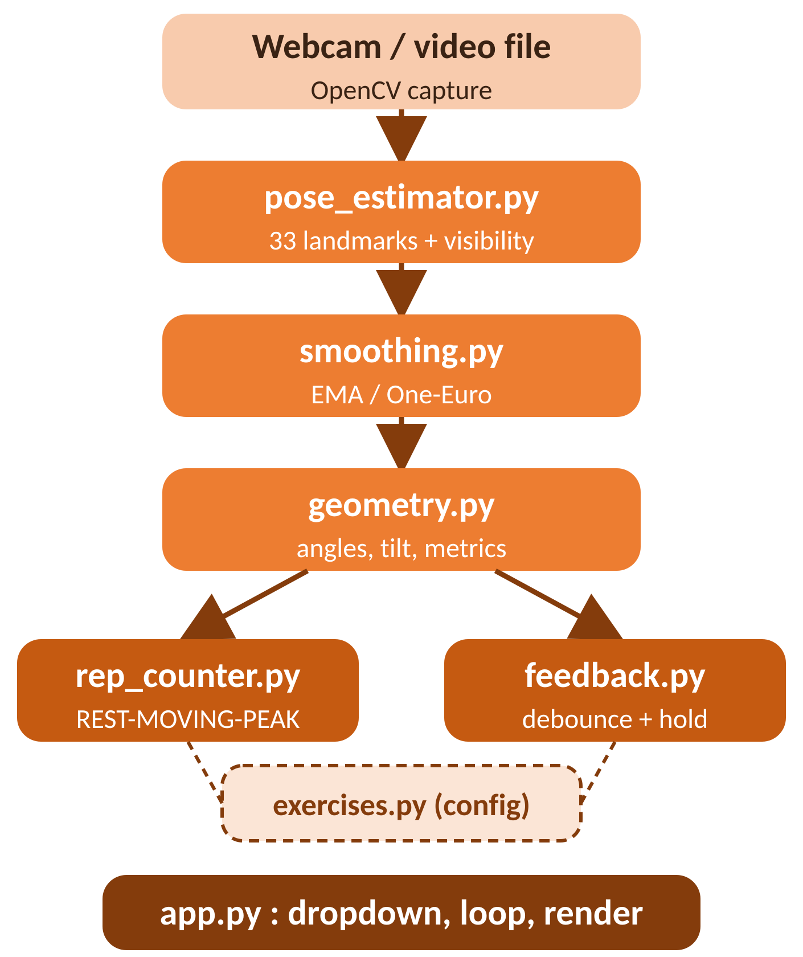
PROJECT DETAILS (Description Of Various Modules)
MODULE 1
pose_estimator.py
Wraps the model, returns keypoint dict
MODULE 2
smoothing.py
EMA and One-Euro filtering
MODULE 3
geometry.py
Angle, tilt and metric computation
MODULE 4
exercises.py
Per-exercise thresholds and rules
MODULE 5
rep_counter.py
UP / DOWN hysteresis state machine
MODULE 6
feedback.py
Rule debounce, hold and priority
MODULE 7
app.py
Dropdown, main loop and drawing
Per-frame data flow and module dependencies

Slide 14

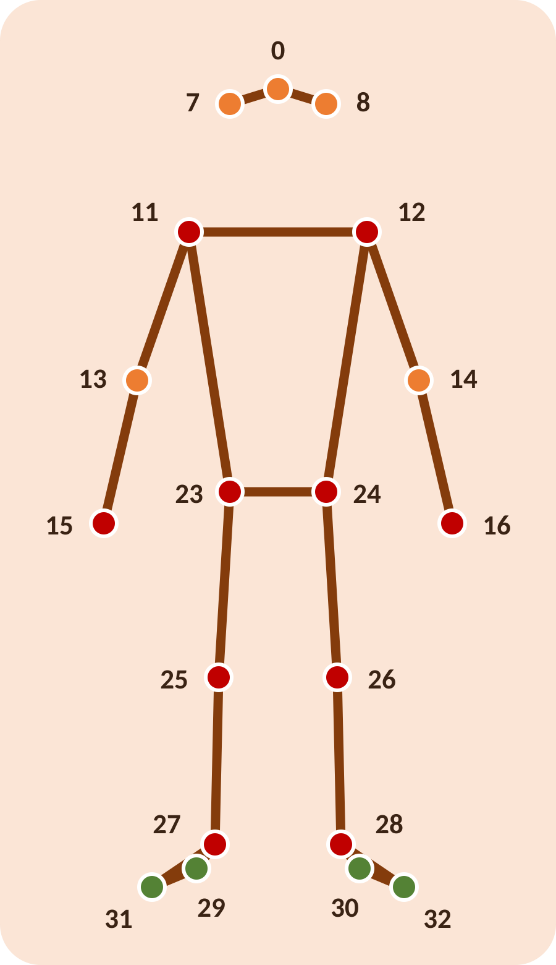
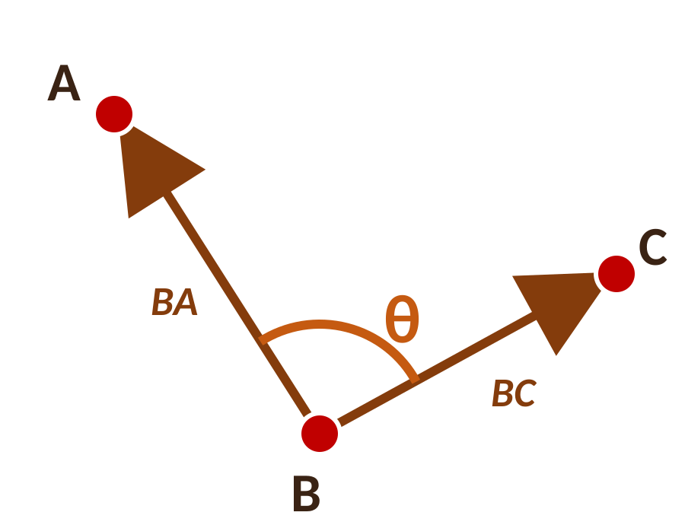

PROJECT DETAILS (Description Of Various Modules)
Pose estimation
Geometry & metrics
θ = arccos( BA·BC / |BA||BC| )
Straight leg about 170–180°, deep squat about 70–90°.
Metrics: knee, hip, elbow, body line, back lean, neck tilt, knee over toe, elbow drift, hip sag.
Smoothing & visibility gating
α = 0.5
0.6 / 0.4
≥ 0.5
EMA on keypoints
angle smoothing
visibility gate
MediaPipe returns 33 landmarks; 19 are used. Heel and foot index enable knee-over-toe, which stays 0 on 17-point backends.
EMA roughly halves ankle jitter; One-Euro follows fast reps while calming slow holds. Low visibility shows “Step back” instead of guessing.

Slide 15
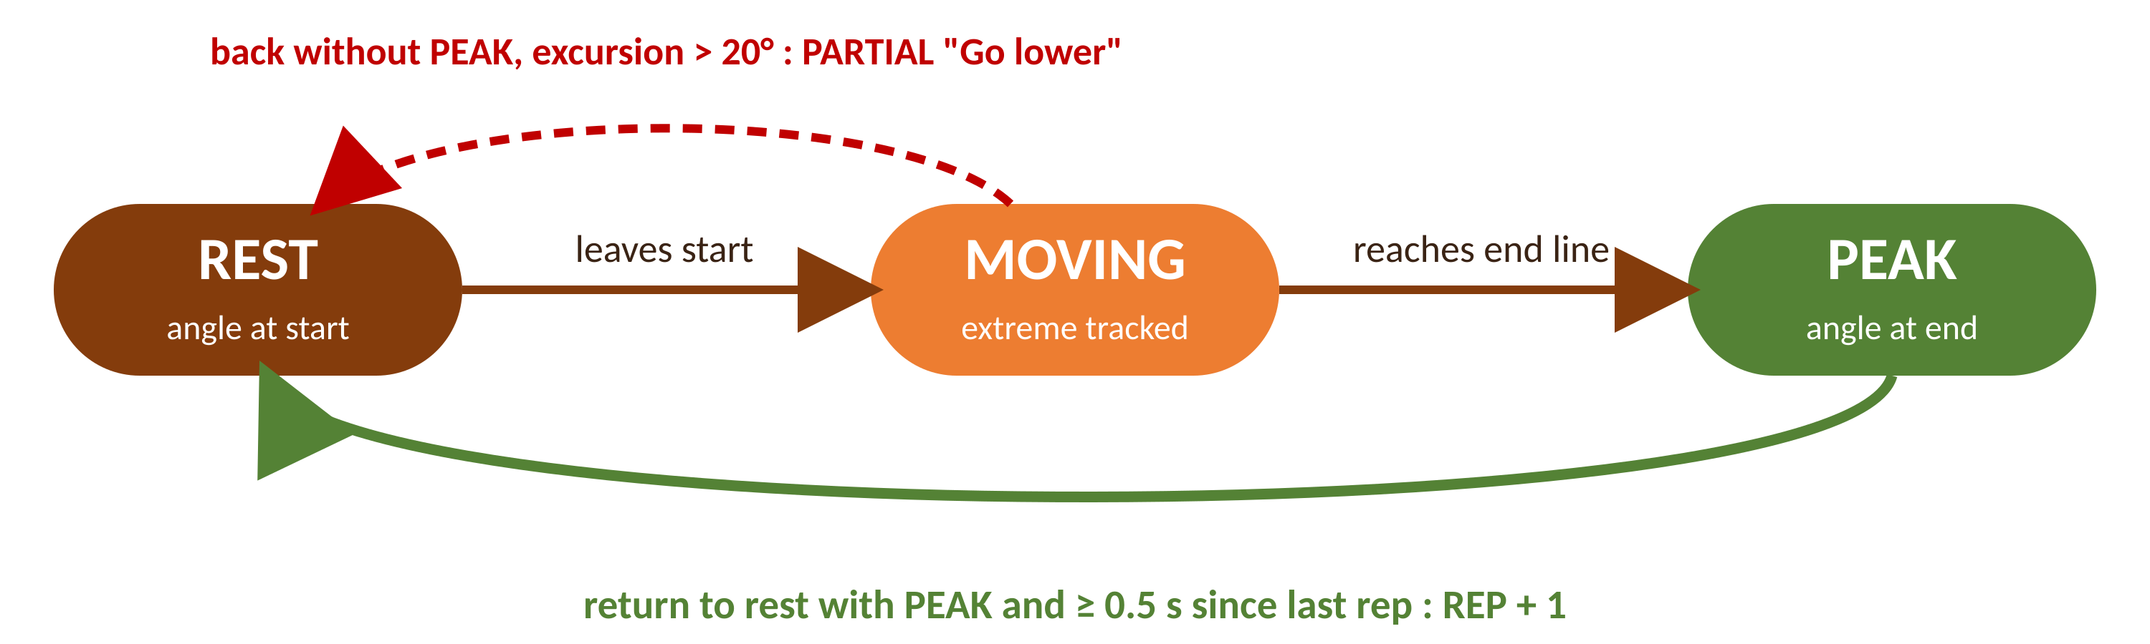


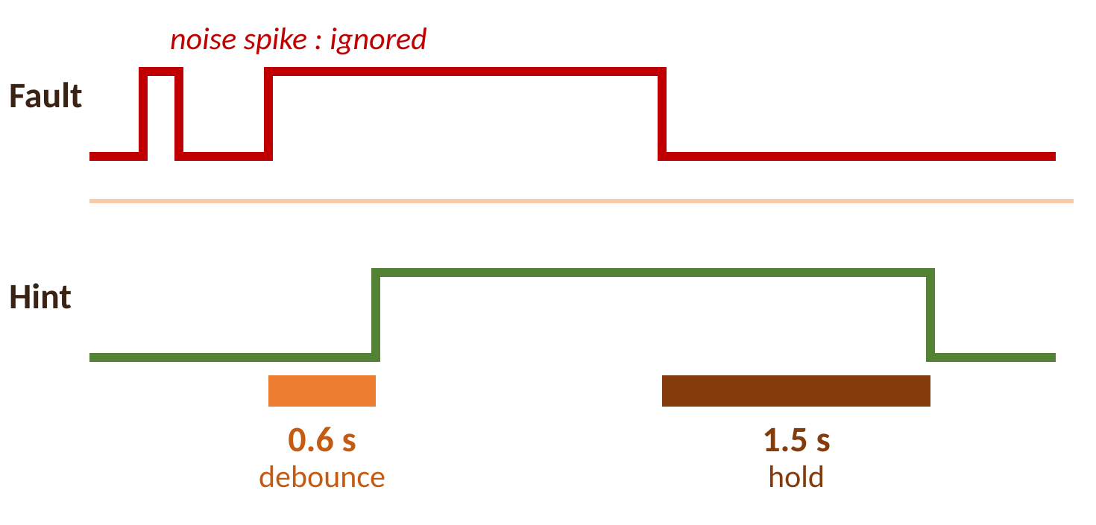
PROJECT DETAILS (Description Of Various Modules)
Rep counter state machine
Feedback debounce and hold
Starter form rules
Exercise | Message | Trigger
Squat | Keep the back straight | back lean > 55° when knee < 140°
Squat | Knees too far forward | knee over toe > 0.30
Push-up | Keep hips in line | body line < 160°
Curl | Do not swing the back | back lean > 15°
Plank | Raise or lower hips | hip sag beyond ±0.06

Slide 16




PROJECT DETAILS (Description Of Various Modules)
Squat
Lunge
Push-up
Bicep curl
Metric: Knee angle
Metric: Knee angle
Metric: Elbow angle
Metric: Elbow angle
160° → 100°
160° → 100°
155° → 90°
150° → 50°
Camera: Side view
Camera: Side view
Camera: Side view
Camera: Side view
Start → End thresholds
Press is direction-reversed (angle grows at the peak). Deadband of 30° or more. A new exercise needs only one dictionary entry.
Shoulder press
Plank hold
Desk posture
Metric: Elbow angle
Metric: Hold timer
Metric: Hold timer
100° → 160°
Good-form seconds
Good-form seconds
Camera: Side view
Camera: Side view
Camera: Side view

Slide 17
RESULT ANALYSIS AND DISCUSSION
1 · Rep count accuracy against hand-counted truth
93.8%
0.07
48
exact rep match (45 of 48 clips)
mean absolute error (target ≤ 0.5)
recorded clips in 5 sets
Clip set | Clips | Exact match | Mean error
Squat good, side view | 12 | 12 of 12 | 0.00
Squat shallow with partial | 8 | 7 of 8 | 0.12
Push-up, side view | 10 | 9 of 10 | 0.10
Curl, front view | 10 | 10 of 10 | 0.00
Press, side view | 8 | 7 of 8 | 0.12
Total | 48 | 45 of 48 | 0.07
Exact match rate per clip set (%)
Both targets met. Of 3 misses, two were fast reps less than 0.5 s apart and one was an occluded push-up where visibility gating correctly paused counting.

Slide 18
RESULT ANALYSIS AND DISCUSSION
2 · Fault detection quality
86.5%
4.5%
4
fault recall (32 of 37), goal above 80%
false alarms (2 of 44), goal below 10%
faults tested on labelled clips
Fault | Recall | False alarms on good
Rounded back in squat | 9 of 10 | 1 of 12
Knees forward in squat | 7 of 8 | 0 of 12
Hips sag in push-up | 8 of 10 | 1 of 10
Swing back in curl | 8 of 9 | 0 of 10
Total | 32 of 37 | 2 of 44
Recall per fault (%)
Misses cluster in dim, backlit scenes where visibility gating prefers “Step back” over guessing. Debounce stops transient spikes from counting as faults.

Slide 19
RESULT ANALYSIS AND DISCUSSION
3 · Backend comparison, speed and stability
Backend | FPS | Rep match | Notes
MediaPipe Lite | 34 | 44 of 48 | Fastest, fewer heel details
MediaPipe Full | 30 | 45 of 48 | Selected default
MediaPipe Heavy | 17 | 45 of 48 | Accurate but below 20 FPS
YOLO11n-Pose | 22 | 43 of 48 | No heel, knee over toe zero
RTMPose-s ONNX | 26 | 44 of 48 | Strong accuracy-speed balance
Speed on laptop CPU (FPS)
≈ ½ jitter
No hover counts
No double counts
EMA at 0.5 roughly halves ankle jitter
Deadband of 30° or more stops threshold chatter
0.5 s minimum interval blocks fast bounces
MediaPipe Full is the default: it matches Heavy on counting, stays above the 20 FPS target and keeps heel-based rules that 17-point models cannot fire.

Slide 20
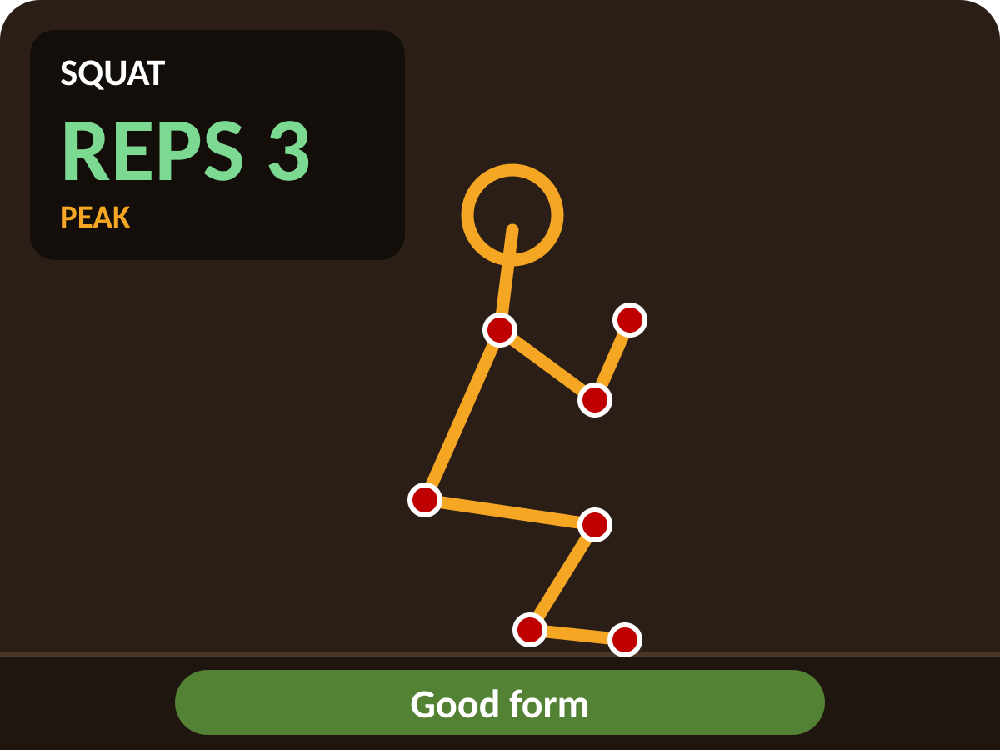
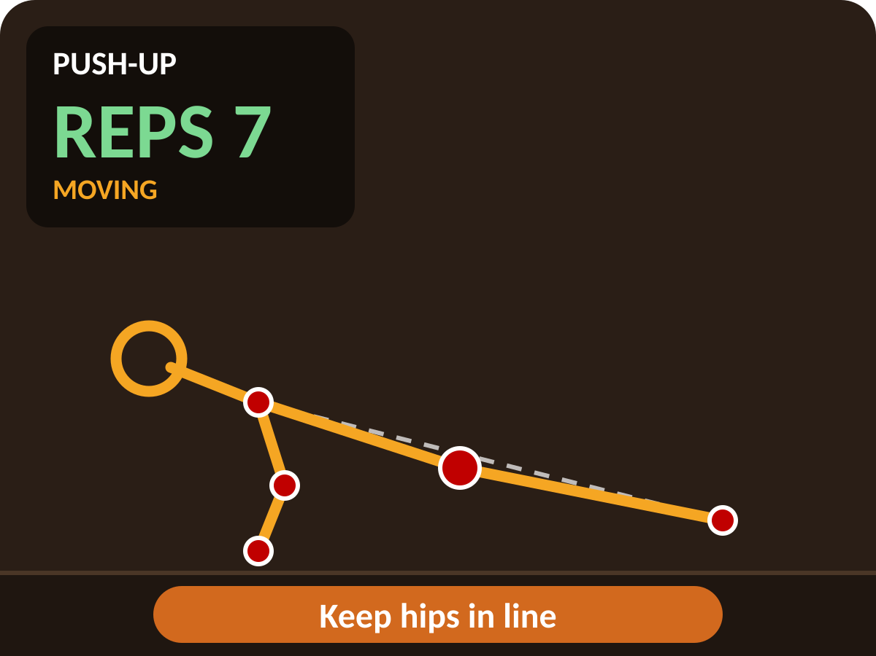
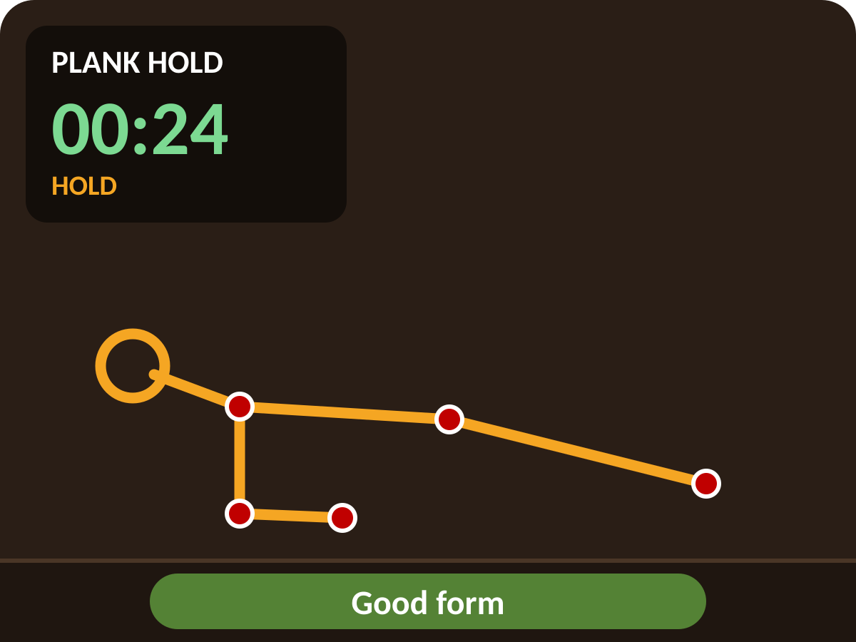
SCREENSHOTS OF RESULT (If Any)
Squat
Skeleton locked to limbs, green REPS, stage PEAK
Push-up
Hips sag: orange coaching hint appears
Plank hold
Good-form seconds counted as HOLD timer
On-screen HUD legend
Amber lines: skeleton links with visibility above 0.5
Red dots: tracked joints
Green: REPS count and Good form
Orange: coaching hints
Illustrative renderings of the BarBeCue interface. Replace with screenshots from your own demo runs.

Slide 21

CONCLUSION & FUTURE SCOPE
Conclusion
Future scope
No GPU, no training. A pre-trained pose model plus careful geometry, filtering and state design gives a usable live coach on a normal CPU.
Stable output. Unified EXERCISES dict, one detect() interface, hysteresis and debounce solve flicker and double counts.
Targets met. 93.8% rep match, 86.5% fault recall, 4.5% false alarms.
Private and safe. Local processing, consented recordings, general hint wording.
1
Personal calibration with 3 s stand
2
Rep quality score 0–100 (depth, tempo, symmetry)
3
Learned form classifier (RandomForest)
4
Voice coaching and rep beeps
5
Faulty joint highlighting
6
Automatic exercise recognition
7
Session history with weekly charts
8
Fatigue detection across a set
9
3D world landmarks, side-on warnings
10
Mobile (TFLite) and multi-person gym

Slide 22
REFERENCES
[1]
Bazarevsky, V., Grishchenko, I., Raveendran, K., Zhu, T., Zhang, F., & Grundmann, M. (2020, June). BlazePose: On-device real-time body pose tracking. In Proc. CVPR Workshops (pp. 1–8).
[2]
Google MediaPipe. (2026). Pose Landmarker guide: 33 landmarks, BlazePose GHUM, lite, full and heavy models [Online documentation].
[3]
Jocher, G., et al. (2026). Ultralytics pose estimation docs: YOLO pose models, 17 COCO keypoints, workout monitoring [Online documentation].
[4]
Jiang, T., et al. (2023). RTMPose: Real-time multi-person pose estimation based on MMPose. arXiv preprint.
[5]
Cao, Z., Hidalgo, G., Simon, T., Wei, S., & Sheikh, Y. (2019). OpenPose: Realtime multi-person 2D pose estimation using part affinity fields. IEEE Transactions on Pattern Analysis and Machine Intelligence, 43(1), 172–186.
[6]
TensorFlow. (2026). MoveNet Lightning and Thunder: Lite pose estimation overview and TF.js announcement [Online documentation].
[7]
Lin, T., et al. (2014, September). Microsoft COCO: Common objects in context. In Proc. ECCV (pp. 740–755).
[8]
Andriluka, M., Pishchulin, L., Gehler, P., & Schiele, B. (2014, June). 2D human pose estimation: New benchmark and state of the art analysis. In Proc. CVPR (pp. 3686–3693).

Slide 23
REFERENCES
[9]
Casiez, G., Roussel, N., & Vogel, D. (2012, May). 1 Euro filter: A simple speed-based low-pass filter for noisy input. In Proc. CHI (pp. 2527–2530).
[10]
OpenMMLab. (2026). rtmlib: Lightweight RTMPose inference without mmcv or mmpose [GitHub repository].
[11]
Community repositories. (2026). AI personal trainer OpenCV MediaPipe and MediaPipe pose squat counter examples [GitHub search].
[12]
Ultralytics. (2026). Workout monitoring solution: Push-up, pull-up and squat counting with keypoint angles [Online solution guide].
[13]
Fit3D & Human3.6M. (2022). 3D fitness and motion capture datasets for biomechanical comparison [Dataset references].
[14]
Xu, Y., et al. (2022). ViTPose and HRNet studies for high accuracy pose estimation [Conference papers].
[15]
Kaggle contributors. (2026). Exercise video sets with squat, push-up and curl clips [Kaggle datasets].

Slide 24



PUBLICATION DETAILS
Conference Date :
To be decided (draft under preparation)
Conference Name :
Target: institute symposium and undergraduate student tracks
Paper Status :
Under preparation. Patent: not applicable.
Draft title
BarBeCue: Real Time Barbell Posture Cues From Webcam Pose Angles
Based on Chapter 5 results (Fig. 5.1 and Fig. 5.2). Test dataset is private under written consent.

Slide 25
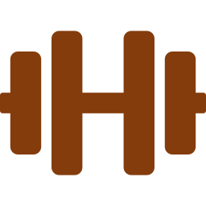
BARBECUE – LIVE POSTURE DETECTION AND REP COUNTER
Thank You
Questions and discussion are welcome

